Slide 1



Energy Disaggregation Using Adjusted STL Method
Rafael Zimmermann – 05/11/2024

Slide 2
Presentation
Note on English proficiency:
I would like to mention that my English may not be perfect, which might sometimes limit my ability to argue with full effectiveness.
Should any doubts remain or the answers are not entirely satisfactory, I am more than willing to clarify them via email, where I can respond with greater accuracy and time.
Advance apologies:
I apologize in advance for any gaffes or uses of language that may seem inappropriate or incorrect.
Please understand that if there is a misunderstanding, it was not my intention, and what I meant might not have been what was interpreted.
Rest assured that any mistake will not be intentional and that my aim is always to communicate clearly and respectfully.

Slide 3
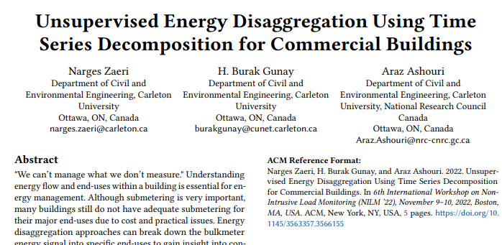
Main work reference
It focuses on identifying the energy from plugs and lighting through decomposition.
Then, it isolates the energy used for heating or cooling.
The article, while quite vague in many details, gives the main idea of my model.

Slide 4
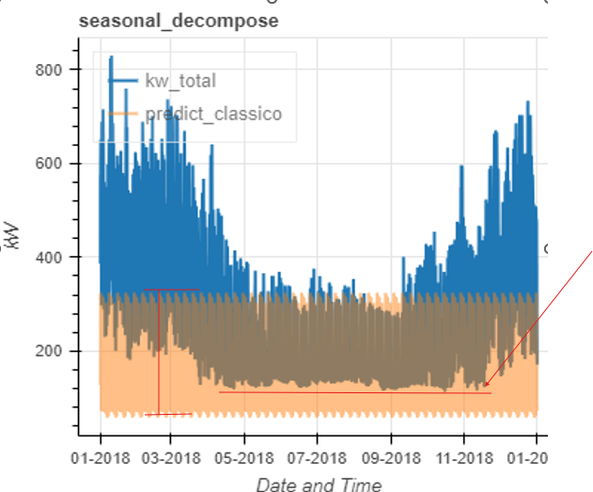
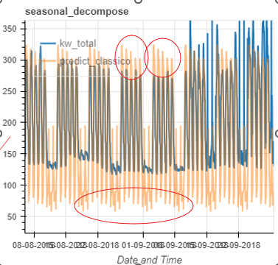
Initial Approaches and Challenges - Classical Decomposition
Positive Points:
It can provide very consistent and rigid forecasts.
Ideal for high-quality data with constant seasonality and trends.
Negative Points:
Difficulty in adjusting the base and height of the data, requiring an algorithm to make this adjustment.
Rigid in adapting to variable and noisy seasonalities.
Difficulty in dealing with missing, dirty or outlier data
Difficulty in adjusting the base and height of the data
Rigid in adapting to variable and noisy seasonalities

Slide 5
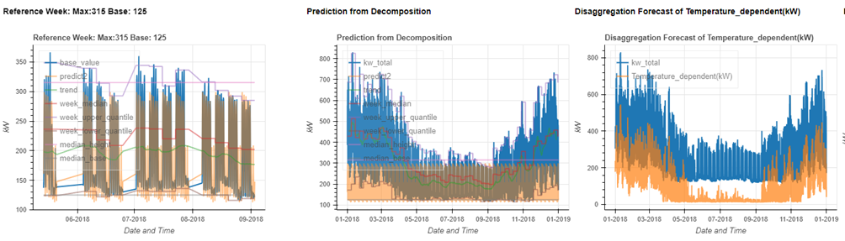
Optimization that Finds Better Adjustment Values for Height and Base of Forecasts
The first idea to solve this problem was an optimization system, which selected the reference weeks and then adjusted the height and base of the data to this reference week using optimization.
Reference week = Data from weeks between the 0 to 0.25 quartile of the data.
This worked very well for good quality data with low noise and constant seasonality, as is the case in the figure below.
Selected reference weeks
Plug and lighting forecast
Temperature energy disaggregation

Slide 6
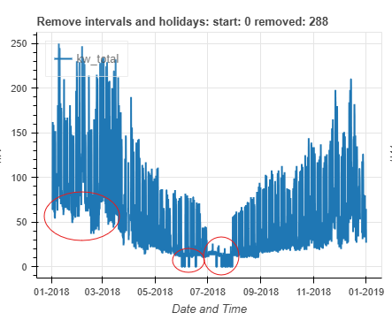
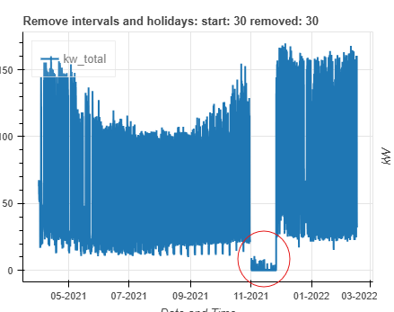
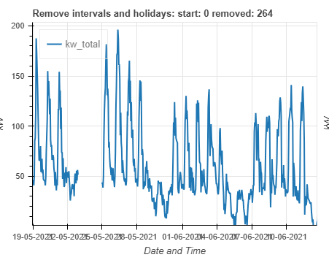
Next logical step – Robustness and generalizability
Next Steps to Improve the Algorithm:
Make the model more robust. (Ability to generalize to real-life data)
Low quality, Noise, Vacations, Holidays, irregular seasonality, strong and inconstant trend.
Vacations, Holidays, Trend and Seasonality not constant
Holidays, noise, seasonality and irregular trends
Vacations and Holidays

Slide 7
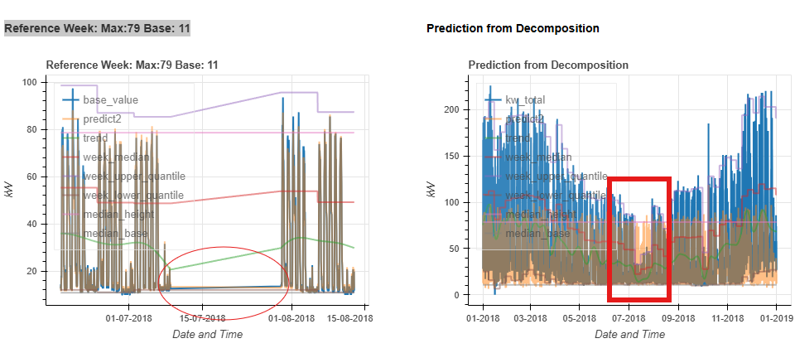
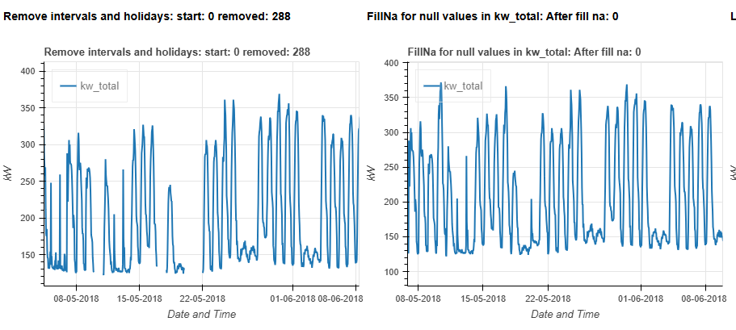
Solution for vacations, holidays and missing data
Part 1 - Clean the data:
Drop holidays and missing data
Replace them with their closest seasonal data using a hour and day of the week clustering to impute the null data
Part 2 - Reference Weeks:
Select the Reference Weeks so that it ignores:
Holidays or vacations weeks
Noise or atypical weeks
Select weeks with the lowest energy consumption that reflect typical usage patterns for plugs and lighting, ensuring the weeks chosen represent normal activity levels.

Slide 8
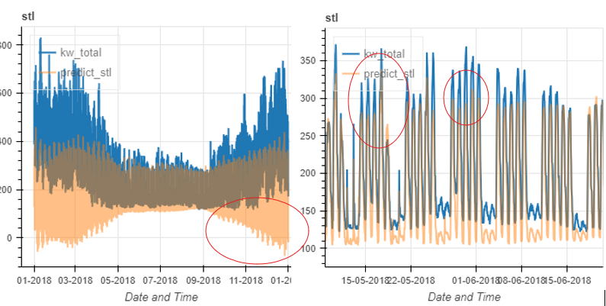
Solution to Irregular Seasonality and Trends
To have a decomposition algorithm that adjusts to irregular seasonality, STL was a good choice, as it can adjust to seasonality almost perfectly, but it generates a problem of instability in its predictions.
Positive:
Flexible and robust to noisy, irregular and low-quality seasonal patterns.
Negative:
Tendency to over-amplify data, causing distortions.

Slide 9
How to solve the problem of distortions in forecasts?
How to solve the problem of distortions in STL predictions?
its adaptability in seasonal predictions is too good to be ignored, if it is possible to stabilize its predictions it has the potential to be a very robust method to real-life data. (which tends to be non-perfect with outliers and irregular seasonality)

Slide 10
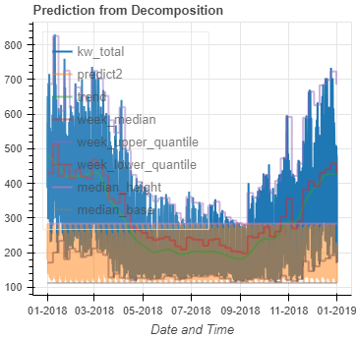
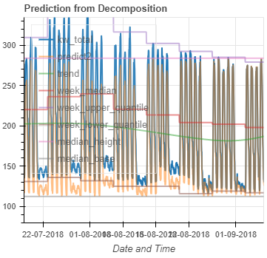
Solving the problem of forecast instability
Use the Reference Weeks to mark the highs and lows of the forecasts, and then normalize these forecasts using the highs and lows of the Reference Weeks.
Pros of the Adjusted STL Method:
Combines stable baseline and trend components with seasonal adaptability
Effective even with imperfect or noisy data, reducing the need for rigorous cleaning.
Cons of the Adjusted STL Method:
Requires accurate identification of stable reference weeks, which can be challenging in highly variable data.
The figure illustrates how Adjusted STL effectively combines seasonal adaptability with precise control of forecast height.

Slide 11
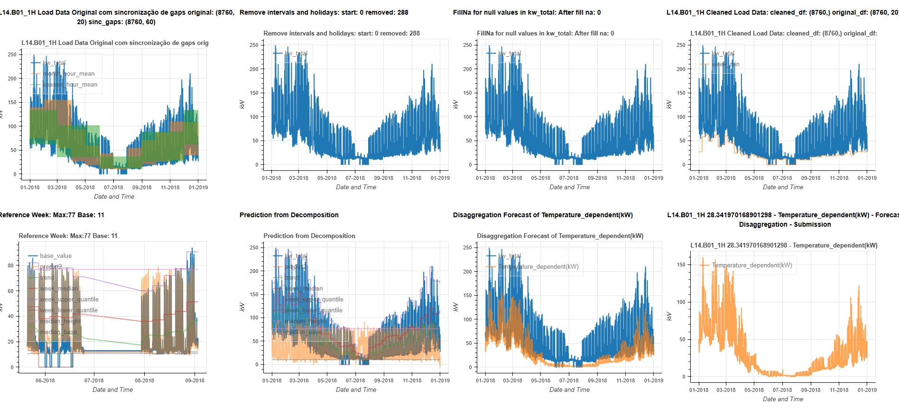
Adjusted stl execution pipeline
My suggestion is to perform the process by visualizing and checking the execution of the data using graphs and plots 1 by 1, adjusting the main parameters of the algorithm:
1- Preprocessing and Data Cleaning:
Fill in and adapt the parameter values
2- Selection of Stable Reference Weeks
Identify the reference weeks and adjust the parameters until they are selected correctly
3- STL Decomposition:
Check if the decomposition is in accordance with the data and, if necessary, make adjustments to the STL parameters
4- Evaluate the forecasts
Check whether the forecasts make sense and are not distorted

Slide 12
Algorithm limitations
Main limitation of the algorithm:
Manual selection of reference weeks:
I understand that it may seem like a manual process, but to run any algorithm satisfactorily, a manual data cleaning process would have to be carried out. In fact, my algorithm can skip this step, but it requires a manual process of selecting the reference weeks, which proved to be more effective in the results and easier to do.
A fully automatic model of the algorithm was tested, using logic to select the most appropriate reference weeks or locking them in values ​​with quantile 0.15 or 0.25. There was no major loss in the results, especially if the data is of high quality. However, adjusting for each building and case, ensuring the best adaptation, undoubtedly generates better results.
More complex heating and cooling systems:
Some buildings have more advanced heating and cooling control systems, requiring an additional disaggregation step. I can only speculate that there are other systems, and that calculating lighting and plugs is not enough, requiring a method to disaggregate the remaining energy from the disaggregation of plugs and lighting.
Some alternatives for this are covered in my report.

Slide 13
Future work
A very strong algorithm to be used in certain buildings where it fits very well
Future work ideas:
Selection of an ideal scenario for use of the adjusted STL
Well-defined reference weeks in the seasons
Simple heating or cooling systems.
Selecting a scenario in which the algorithm may not perform well
Reference weeks hardly separated by seasons
More complex heating and cooling systems

